Slide 1

DSCI-6612- INTRO TO
ARTIFICIAL INTELLIGENCE
Team MemberS:
Sri Charana Indaram
Shivani Shivalenka

Slide 2
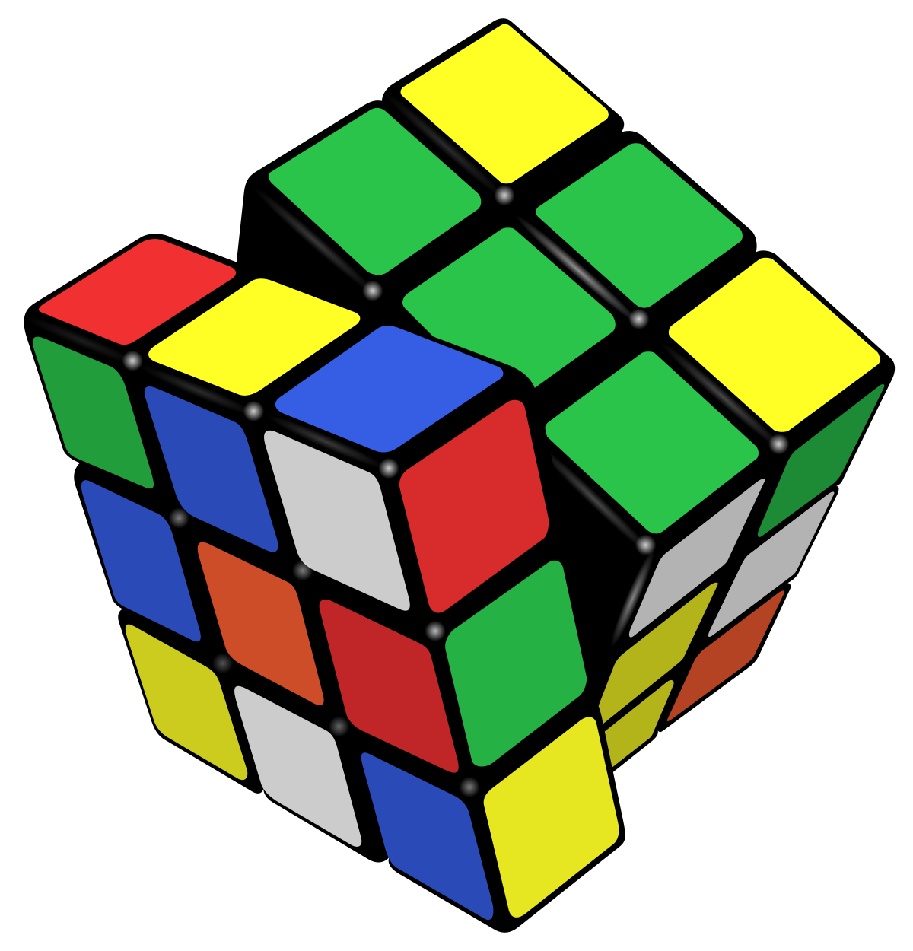
REINFO CUBE
REINFORCEMENT LEARNING FOR A RUBIKS CUBE

Slide 3
CONTENTS
ALGORITHM USED
HOW DOES OUR ALGORITHM WORK?
CODE FRAGMENTATION
OUTPUT
CODE
CONCLUSION

Slide 4

ALGORITHM USED
The concept used to solve a Rubik's cube here is Q-Learning from Reinforcement learning
Q-learning is a model-free, value-based reinforcement learning algorithm.

Slide 5

HOW DOES OUR ALGORITHM WORK?
Q-Learning Iteration:
Perform Q-learning over specified episodes, updating state-action pairs.
Initialization:
Initialize Q-values and rewards for effective learning setup.
Exploration vs. Exploitation:
Balance exploration and exploitation based on a random policy value.
Action Selection:
Choose the action with the highest Q-value during exploitation.
Q-Value Update:
Update Q-values using the Q-learning formula, incorporating rewards and discounted maximum rewards.

Slide 6

CODE FRAGMENTATION
The project is an integration of the following files:
agent.py -
cube.py -
play.py -
qLearn.py
utils.py

Slide 7
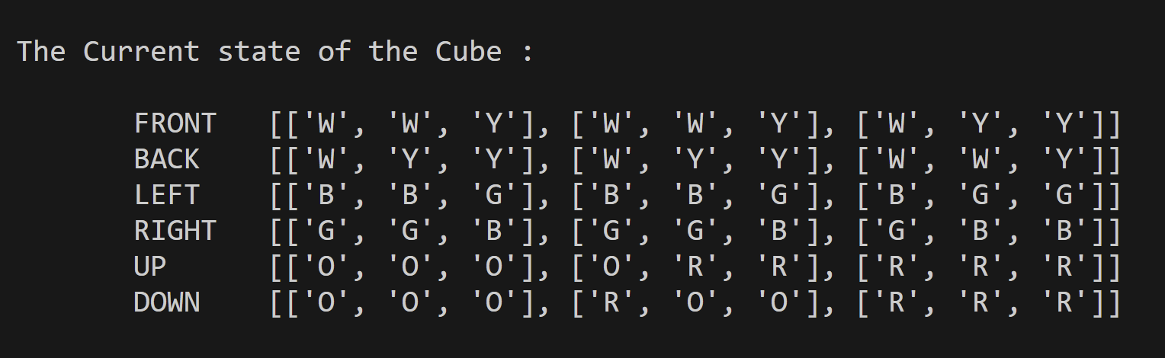
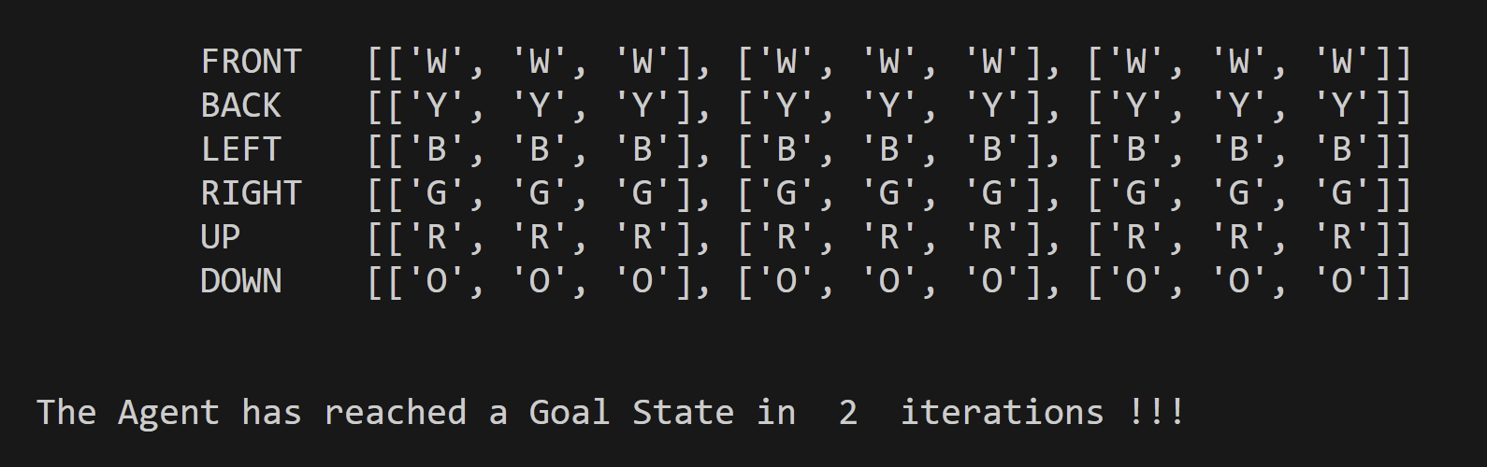
OUTPUT
INTIAL STATE (RANDOMLY SHUFFLED):
:FINAL STATE (END GOAL)

Slide 8
CODE

Slide 9
CONCLUSION
In conclusion, the successful application of Q-learning to solve the Rubik's Cube presents a promising model for mastering complex problem-solving tasks.
This achievement not only demonstrates the versatility of reinforcement learning but also highlights the potential for leveraging similar approaches in solving other intricate problems.

Slide 10

THANK YOU

